Slide 1
CHAPTER 2
Management Theory
Presented by: Reyoz Kumar Rayamajhi

Slide 2
Theory
A theory is conceptual framework for organizing knowledge and providing a blueprint for action.
Management theories are used to build organizations and guide them towards their goals, are grounded in reality.
Understanding the historical context of management provides a sense of heritage and can help managers avoid the mistakes of others.

Slide 3
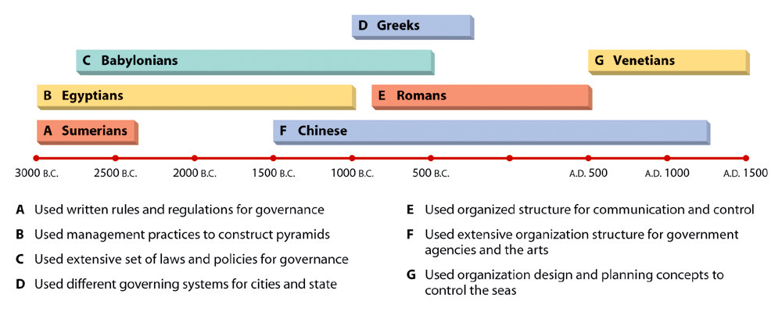
Figure 2.1: Management in Antiquity

Slide 4
The Three Traditional Management Perspectives
The Classical Management Perspective:
  Ideas of the early 20th century theorists and managers converged with the emergence and evolution of large-scale business and management practice.
  This perspective actually includes two different viewpoints: scientific management and administrative management.
  Scientific Management Concerned with improving the performance of individual workers.
Frederick Taylor developed this system, which he believed would lead to a more efficient and productive work force.

Slide 5
Scientific Management
F.W Taylor(1856-1915)
He was the father of Scientific Management
Pioneering works on production and efficiency
He worked for Midvale Steel Company later Bethelen Steel Company
In both company he observed production and pay were very poor.

Slide 6
Problems
It was develop to solve two major problems:
How to increase the output of average worker?
How to increase the efficiency of management?
Thus it advocate the application of scientific method to analyze work to determine how to complete production task efficiently.

Slide 7
Study (Using his engineering background)
Taylor studied standards and the relationship of output to wages in these steel companies.
To overcome the problems of inefficiency(emphasize on Scientific Management Theory)
Time and motion studies.
He stressed the need for hiring and training workers
Reduction of wastage.
Another significant elements of Taylor approach was the use of the different piece rate system
Assumed providing monetory incentives could motivate workers(i.e. standard output= addational wages).

Slide 8

Continue….
He believe that worker tend to restrict their output because of their fear of displacement.
Produced more = Earn More
Worker
Separate economy entity(men)
Financial needs

Slide 9
Continue….
Taylor entire approach to scientific management was the idea that there is “One Best Way of Doing Every Things”.
The Industrialist and Manager of that time in USA welcome Tailor view(Standard)

Slide 10
Major Principle of Taylor SMT
STANDARDIZATION: (Avoid rule of thumb)
Standard of work, equipment and process should be fixed by scientific studying the nature of work.
TIME AND TASK STUDY: To determine the standard for the workers.
There should be One best way to do the work.
SYSTEMATIC SELECTION AND TRAINING: The operatives should be selected, taught, trained and develop scientifially.
PAY INCEMTIVES: The output should be linked with pay for employee motivation.
Payment for the amount of work done.
Effort Reward relation(Productivity).

Slide 11
Continue…
CLOSE COOPERATION BETWEEN MANAGER AND OPERATIVES: Cooperation should be encourage to accomplished work. Division of work, incentive system.

Slide 12


